Slide 1
TOPIC B2:
PROGRAMMING
LESSON B2-7
INTRO TO DATA STRUCTURES & LISTS

Slide 2
AGENDA
Warm-up Question
Static vs Dynamic Data Structures
Arrays/Lists
2D Lists
NOTE!
Have a way to take notes and a way to write code available for this lesson

Slide 3

THE WARM UP QUESTION
Create a trace table for this algorithm:
sum = 10 avg = 0 i = 0 while(i + 4 < 10): sum += i + 5 avg += i + 3 i += 1 avg /= i

Slide 4
THE WARM UP ANSWER
Iteration | sum | avg | i | i+4
0 | 10 | 0 | 0 | 4
1 | 15 | 3 | 1 | 5
2 | 21 | 7 | 2 | 6
3 | 28 | 12 | 3 | 7
4 | 36 | 18 | 4 | 8
5 | 45 | 25 | 5 | 9
6 | 55 | 33 | 6 | 10
 |  | 5.5

Slide 5
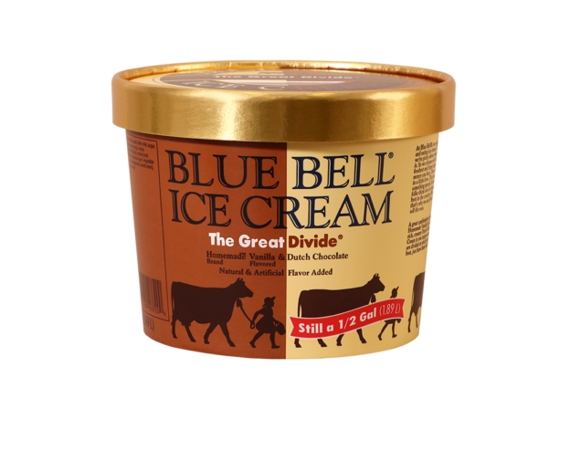
DATA STRUCTURES
A data structure is simply a way of organizing and storing data
Data structures allow for manipulation of the data they contain
Data structures also make their best attempts to be efficient in terms of the speed of the program and how much space they take up
Data structures come in two flavors, static and dynamic
STATIC
DYNAMIC
STATIC

Slide 6
STATIC DATA STRUCTURES
Static data structures have predetermined sizes in the system memory
The size of this memory will not change while the program is running
Each piece of data has a specific place in memory it can always be found
Pros | Cons

Slide 7
STATIC DATA STRUCTURES
Pros | Cons
Quickly access elements (due to known position) using index No worries about overflow or underflow in memory as the size is fixed Simple to program, no need to check size of structure | Inefficient use of memory if data structure is not full Lack of flexibility in sizing Deleting an item may leave an open spot between items, wasting memory Inserting data between two items can be time consuming

Slide 8
DYNAMIC DATA STRUCTURES
Dynamic data structures have no predetermined size
It can grow or shrink during the run of the program
Elements cannot be directly accessed since we don’t always know where they are until we check
Pros | Cons

Slide 9
DYNAMIC DATA STRUCTURES
Pros | Cons
Very flexible, can shrink or grow as needed Efficient use of memory, none is wasted Insertion and deletion of items is very quick and easy | Structure has a chance to overflow or underflow Harder to use in programming Can be less time efficient and take longer to access items

Slide 10
ARRAYS AND LISTS
Lists are a data structure that allow for the storage of elements of the same data type under one variable.
Elements are then accessed using brackets (also known as crotchets apparently) containing an index
The index of the first item is 0
myList = [14, 32, 12, 13, 19] print(myList[0]) print(myList[3])

Slide 11
INITIALIZING LISTS
You can create lists by placing the items you would like in them inside of brackets, like I have on the left
You can also initialize an array with a certain number of items using multiplication
myList = [14, 32, 12, 13, 19] mySecondList = [0]*5

Slide 12
INITIALIZING LISTS
If you use the multiplication to make a list, you may want to loop and even let the user fill in the list themselves
mySecondList = [0]*5 for i in range(0,5): mySecondList[i] = int(input("Enter a whole number: "))

Slide 13
DATA TYPES IN LISTS
Lists can hold multiple data types, but only one data type at a time
names = ["Joe", "Jerry", "Jerome"] score = [88, 12, 100]

Slide 14
PARALLEL LISTS
If the information in two lists is meant to correspond with each other, like these names to grades, they are called parallel lists
Parallel lists are useful, but can be tricky to manage if you are adding and removing items often
names = ["Joe", "Jerry", "Jerome"] score = [88, 12, 100]

Slide 15
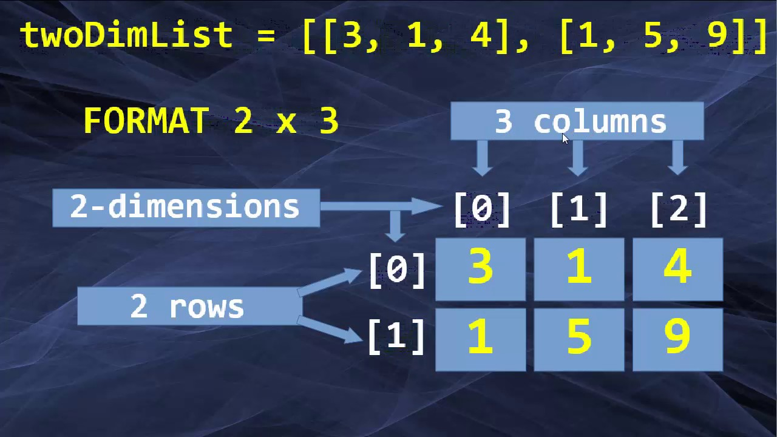
2D LISTS
Two-dimensional, or 2D Lists can be looked at as a table
Two indices are used, one for the row, and one for the column. Rows are always first and columns are always second
This is sort of backwards from how we might think of an X/Y coordinate grid

Slide 16
2D LISTS
Functionally though, a 2D list is just a list of lists
There are a couple of ways to write these out
Note the specific bracket structure of both of these
#this creates and populates a 2D list twoDeeList = [[3, 1, 4], [1, 5, 9]] #this creates a 2D list of a certain #size filled with zeroes numList = [[0 for i in range(2)] for j in range(3)]

Slide 17
ACCESSING 2D LISTS
If you want to access everything inside of a 2D list, you have to use two nested loops
One is for the rows, the other is for the columns
To index it, use the name of the list, and the row and columns in individual brackets.
#this creates and populates a 2D list twoDeeList = [[3, 1, 4], [1, 5, 9]] print(twoDeeList[0,2])

Slide 18
ACCESSING 2D LISTS
NOTE!
Adding , end="" to the end of a print makes it not go to the next line
This example shows a 3x3 list getting initialized, populated, and printed
nums = [[0 for i in range(3)] for j in range(3)]
#populating the list for i in range(0,3): for j in range(0,3): nums[i][j] = int(input("Enter a number"))
#printing the list for i in range(0,3): for j in range(0,3): print(nums[i][j], " ", end="") print("\n")

Slide 19
DYNAMIC LISTS
In Python, lists are dynamic
This means that a list does not have a fixed size
You can initialize a list with a fixed size like we saw earlier to use it in a more ‘static’ way
But if we want to use it dynamically, we use some list functions

Slide 20
LIST APPEND
Appending an item to a list adds it at the end of the list
The item you want to be added is passed in parenthesis
This is similar to how the functions we have written work
myList = [32] myList.append(14) print(myList)

Slide 21
LIST INSERT
Inserting an item to a list specifies the index you want to add it as
The index you want the item at gets passed first, followed by the item itself
myList = [10, 55, 32] myList.insert(1, 14) print(myList)

Slide 22
LIST REMOVAL
Removing an item from a list deletes a specific item
You tell the list the ITEM you want to remove, not the index that item is at
myList = ["Toe", "Jam", "Earl"] myList.remove("Toe") print(myList)

Slide 23
LIST REMOVAL
Popping an item removes whatever item is at a specific index in the list
If you do not specify an index, the final item in the list will automatically be removed.
The popped item can also be stored into a variable to be used later
myList = [[3, 5, 1], [8, 1, 4], [9, 0, 2]] myList[1].pop() subList = myList.pop() print(myList) print(subList)

Slide 24
LIST LENGTH
Length is an attribute of a list just like it is a string
To get the length of a list (the number of items) the syntax is the same as a string
myList = [True, False, False, True, False] print(len(myList))

Slide 25
LIST CLEARING
Clear is a function you can call on a list to remove and delete all elements currently within it
This is… situational to say the least
myList = [True, False, False, True, False] print(len(myList))

Slide 26
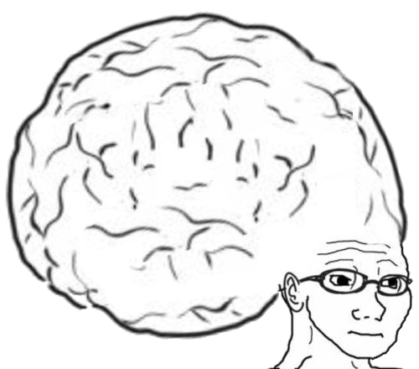
VOCAB TO REMEMBER
Data Structure
Static Data Structure
Dynamic Data Structure
Lists
Parallel lists
2D Lists
Append
Insert
Remove
Pop
Clear
Length

Slide 27
PROGRAMMING ASSIGNMENT
Check the github repository for this class to find PA B2-3!
Good luck, and let me know if you need any help!

